Slide 1
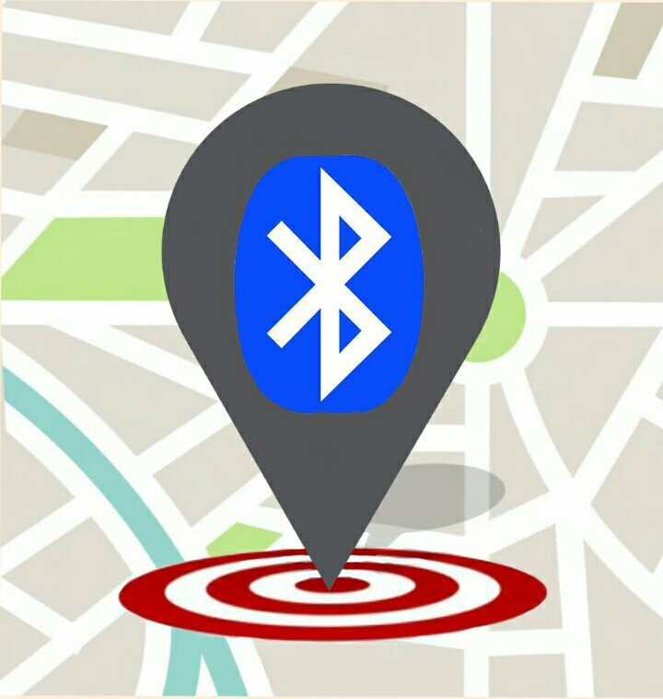
Bluetooth Positioning Device for Child Monitoring
ACSEF 2015-16 ID: MENG-124 (Category 1st Place)
Speaker: Rui Li (Mary) Xu

Slide 2
Background: The issue
Misplacing things and looking after young children in public places are often very stressful experiences
“American children get lost over 2,000 times each day in all kinds of public places such as beaches, amusement parks, fairs and airports”
People have developed many types of tracking devices for humans and easily lost items
Types of signals used: Bluetooth, GPS, WiFi

Slide 3
Engineering Goal:
The design and construction of a Bluetooth device and an accompanying mobile application for parents and caretakers to monitor their children’s location in a close-proximity environment.

Slide 4
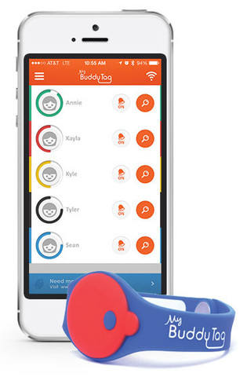
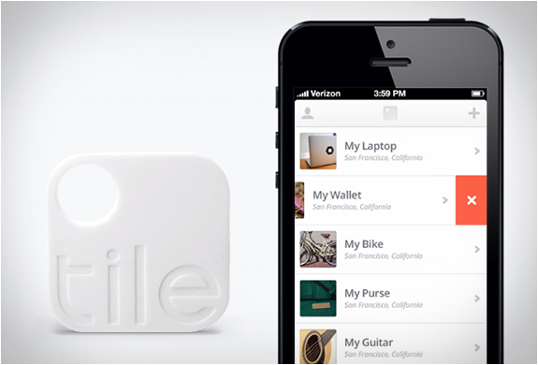
Basic Design
A small tag or wristband is paired with a smartphone app
Examples: My Buddy Tag, Tile, Duet
GPS: long-distance, expensive, inaccurate indoors
WiFi: not available everywhere, monthly fees
Bluetooth: inexpensive, close-proximity
Uses signal strength (RSSI) to give approximate distance away, but not the direction

Slide 5
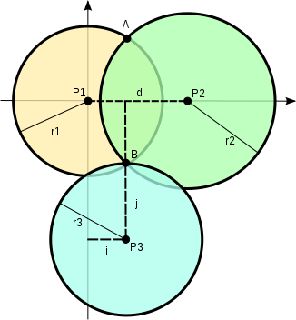
Indoor Positioning Methods
Trilateration using RSSI
Fingerprinting (pre-determined database)
Neural networks
Pros: greater accuracy
Cons: requires multiple beacons throughout the room, set location, updated when conditions change
Good for airports, hospitals, etc.

Slide 6
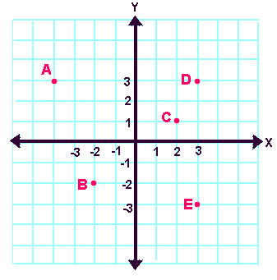
Dead Reckoning
Method of navigation used by sailors/pilots since 17th century
Location is determined by the direction and speed of movement in relation to previous known locations
Bluetooth signal strength used to determine distance traveled from parent device
Magnetometer (aka compass) used to determine direction traveled

Slide 7
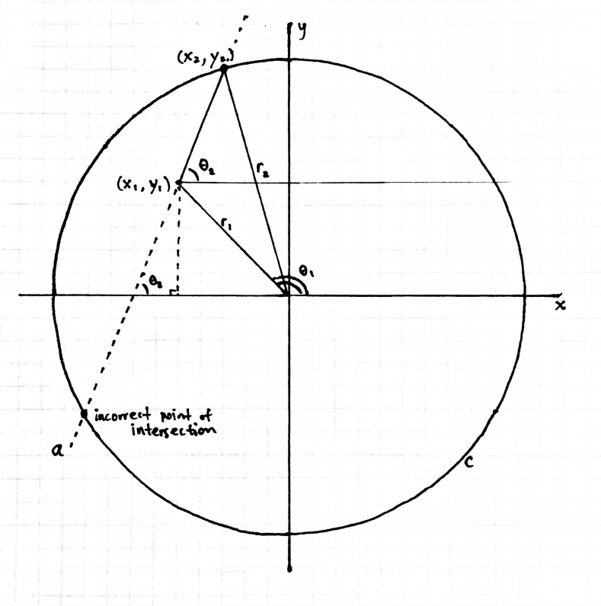
Given: last known position (x,y) and current distance r, direction θ
Create 2 equations with info: circle with radius r and linear line
Solve for intersection(s)
Determine final correct position

Slide 8
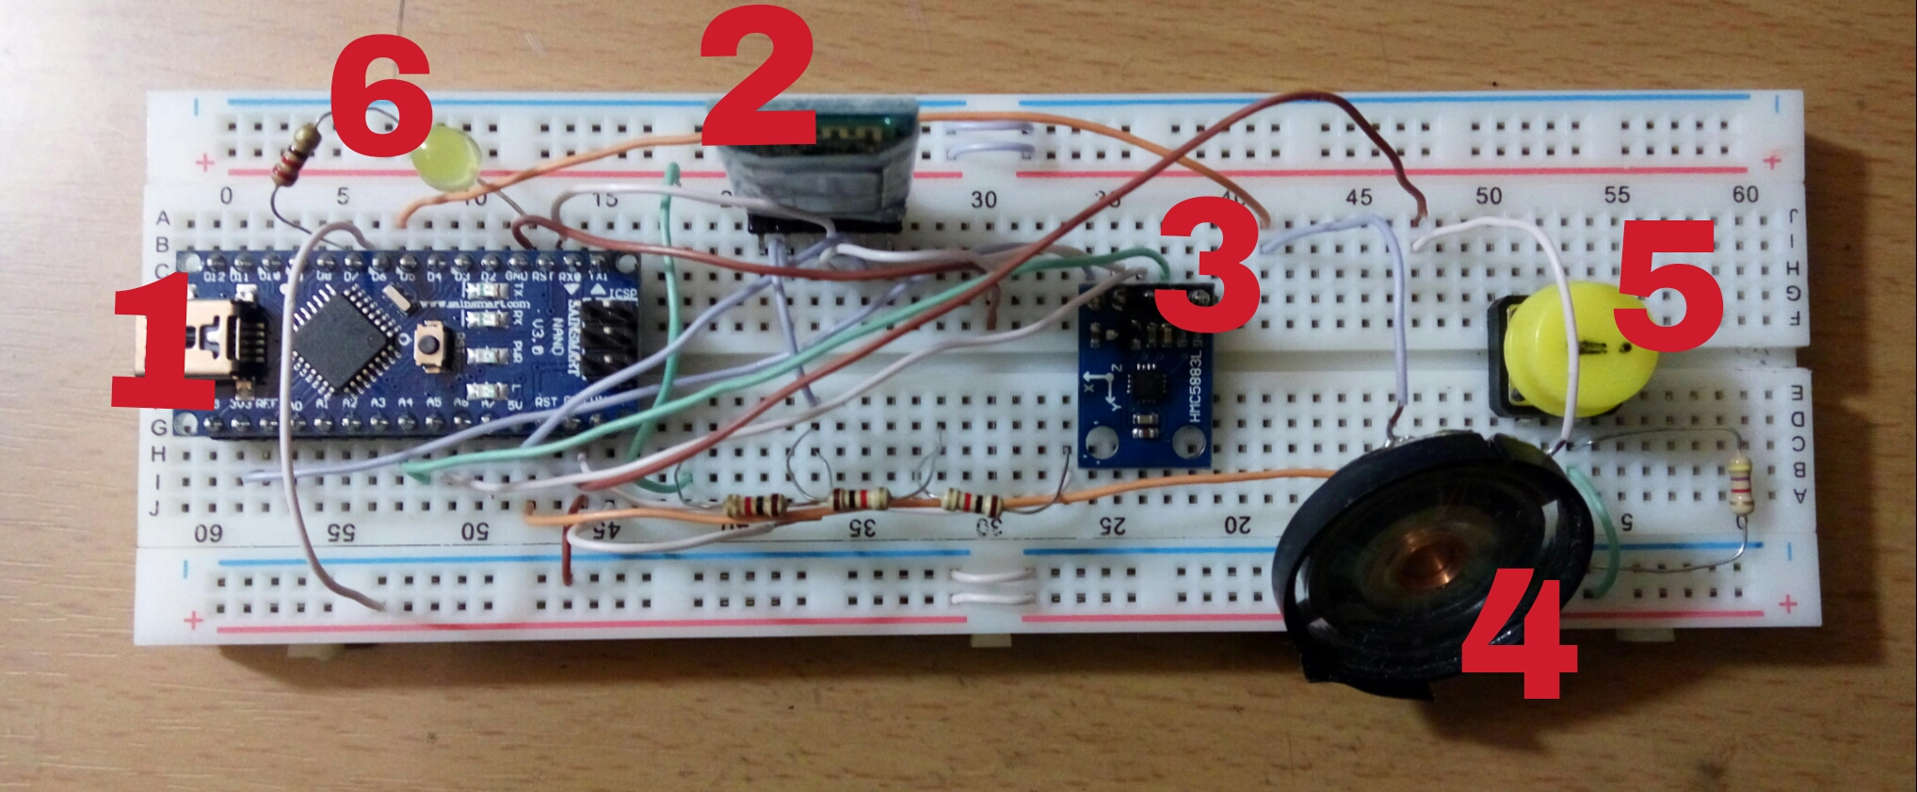
Materials
Software: Android Studio IDE (programming phone application: Java), Arduino IDE (programming microcontroller), “Bluetooth spp pro” application (testing Bluetooth communication)
Hardware: Ardunio Nano powered Bluetooth device: (1) Ardunio Nano microcontroller, (2) HC-05 Bluetooth module, (3) HMC5883L magnetometer, (4) alarm speaker, (5) panic button, (6) warning LED.

Slide 9
Design Criteria
Breadboard model of wearable device for child
Pairs with parent’s phone, constantly provides Bluetooth signal and magnetometer readings, contains an alarm and a panic button for basic communication (~30 USD)
Application for Android smartphone/tablet (Bluetooth compatible)
Opening screen prompts user to connect to wearable, processes received data, displays position on graphical interface, notification for “out of range”
Bluetooth connection range: Class 2 (10 m), extended with antenna to ~30-50m (depends on phone range)

Slide 10
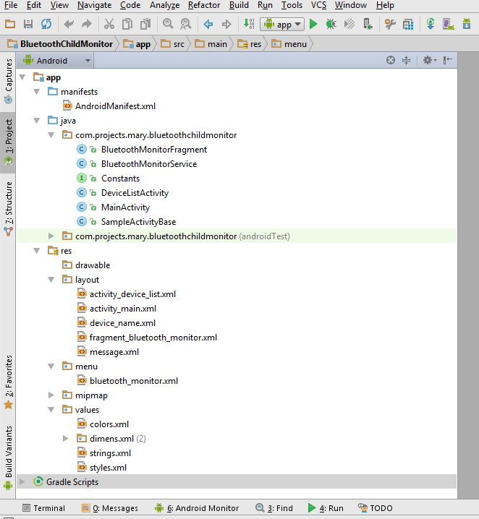
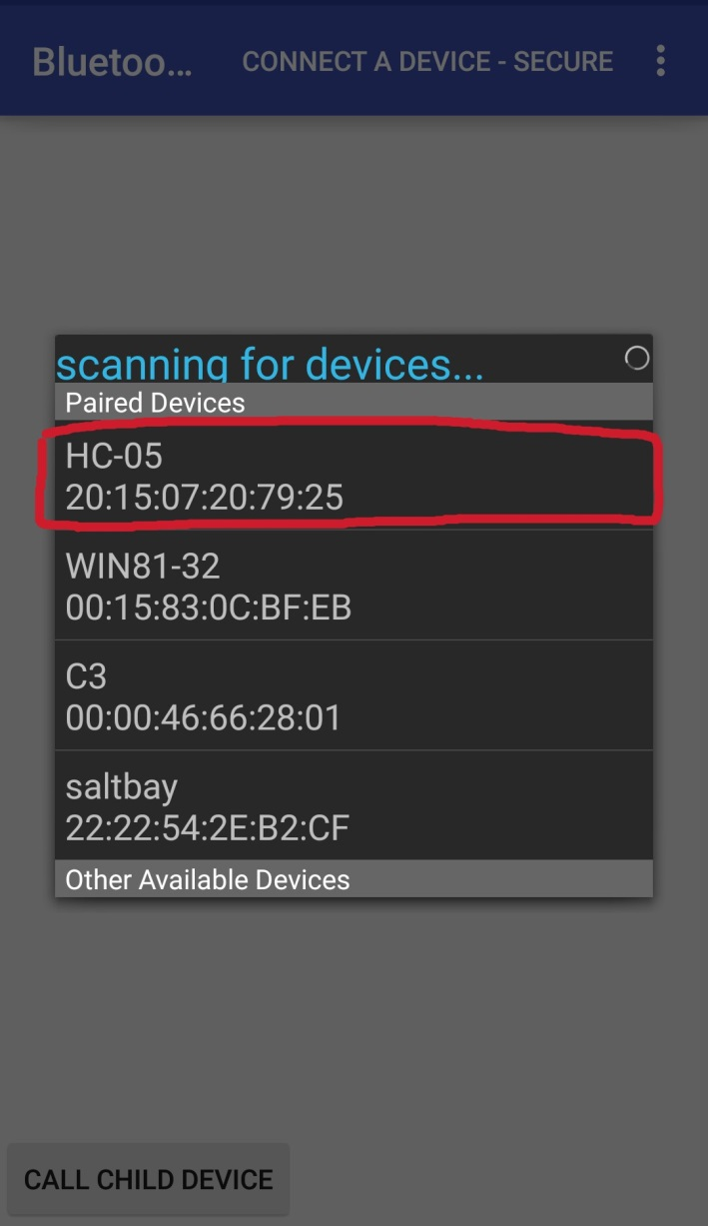
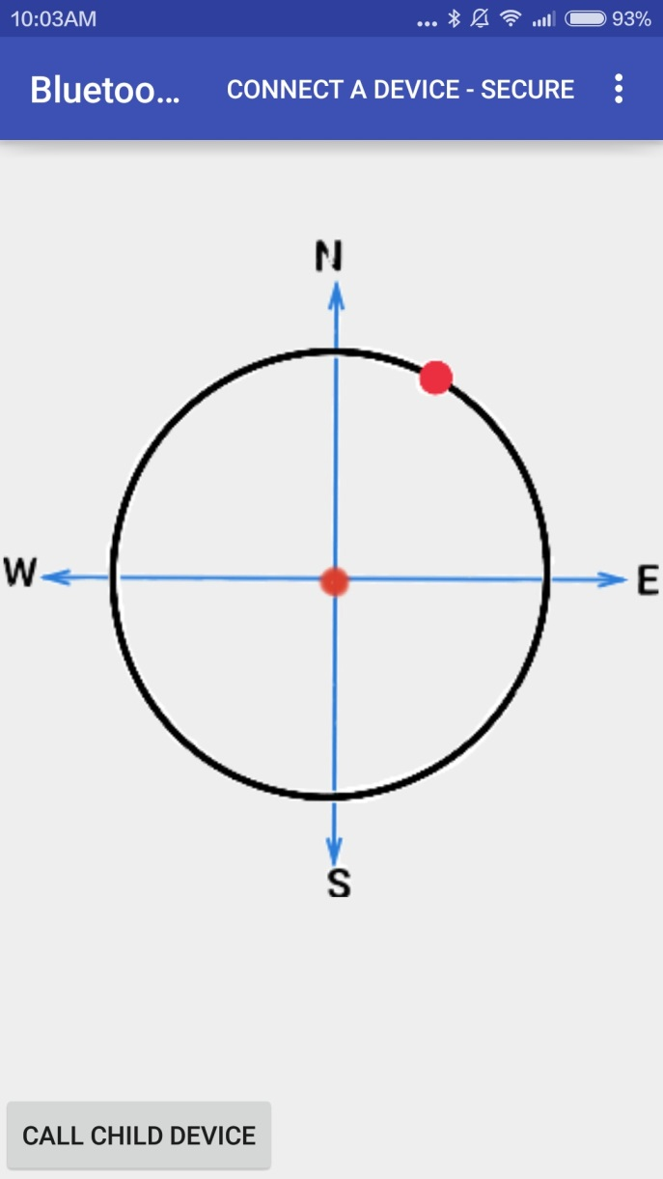
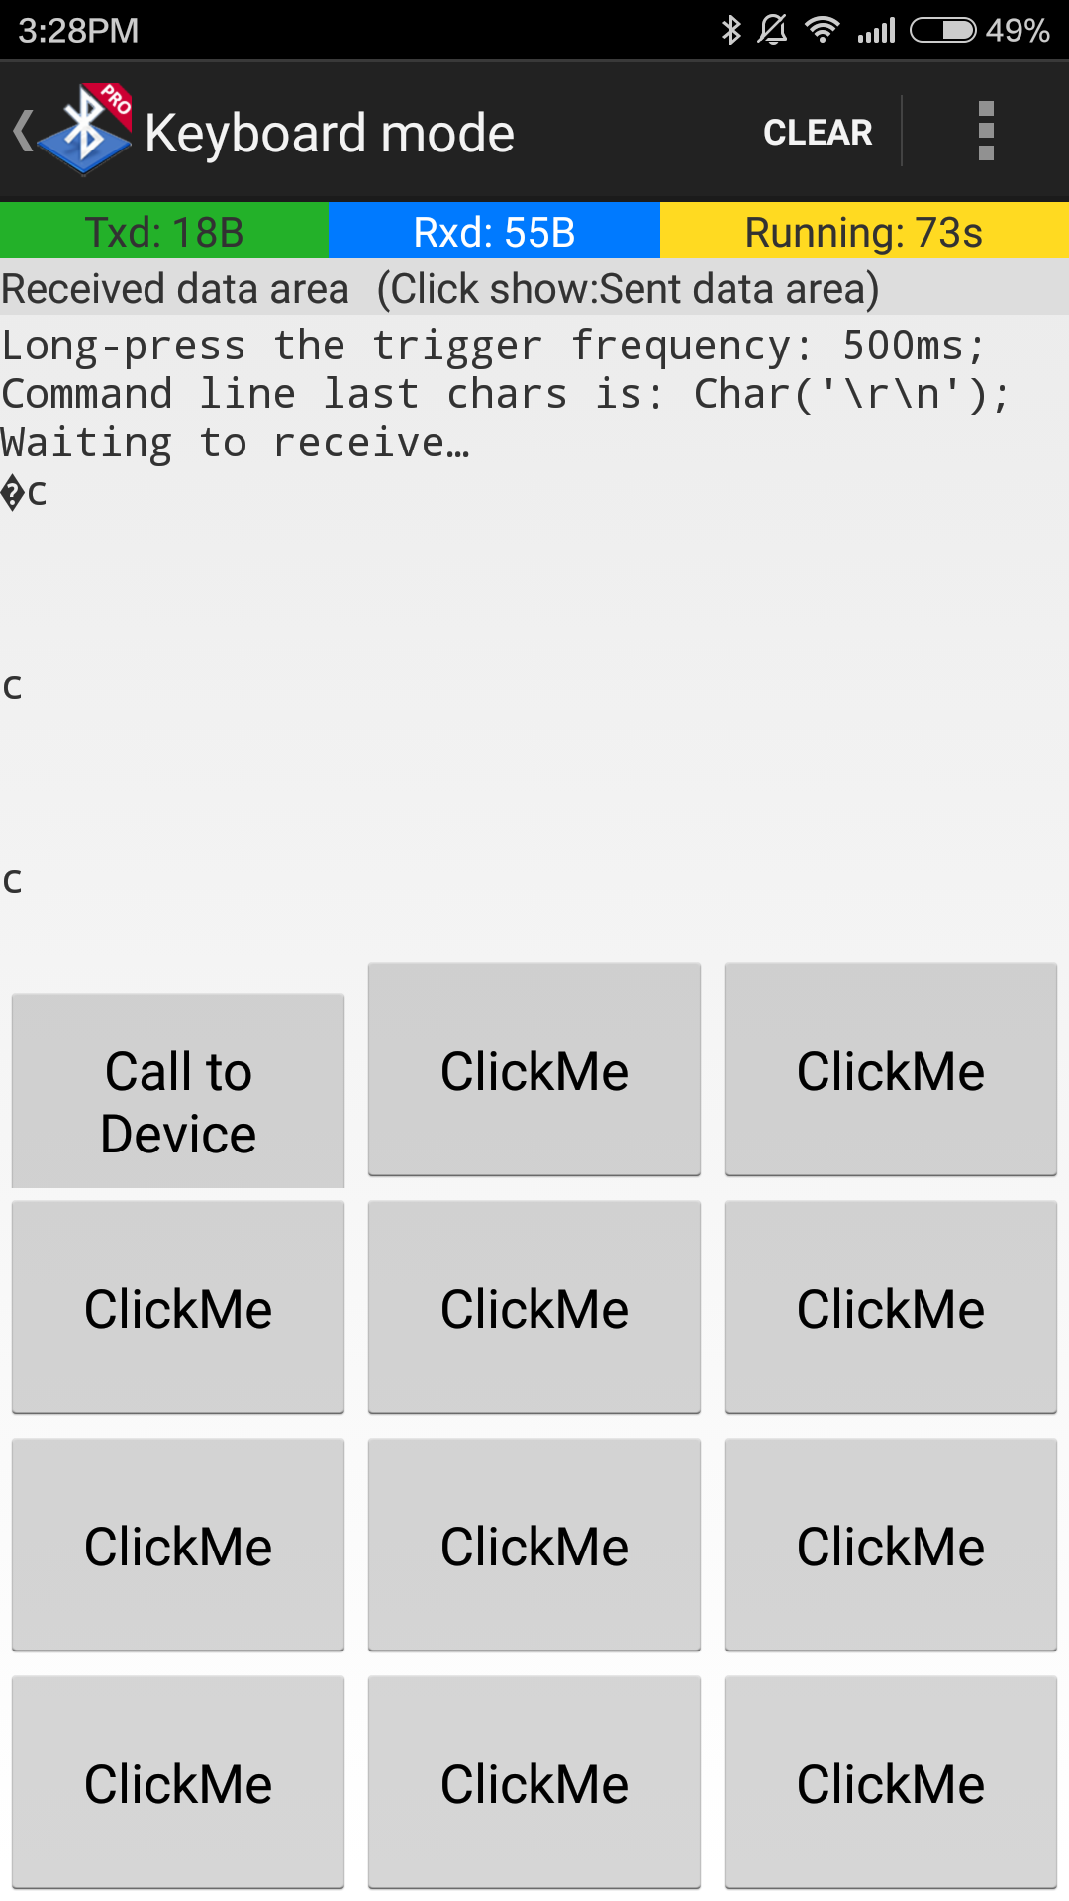
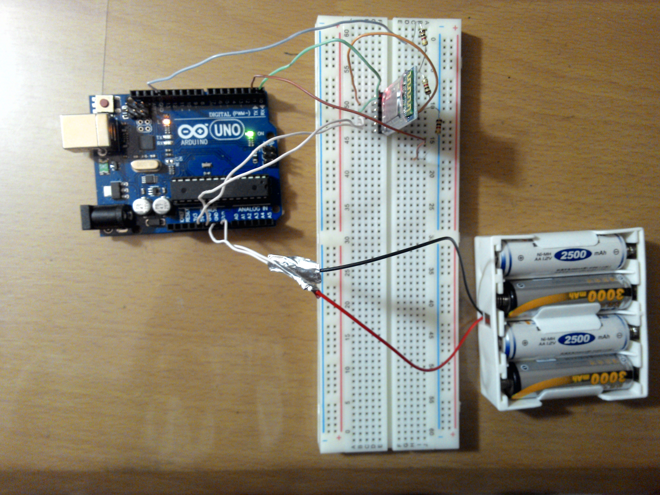
Progress

Slide 11
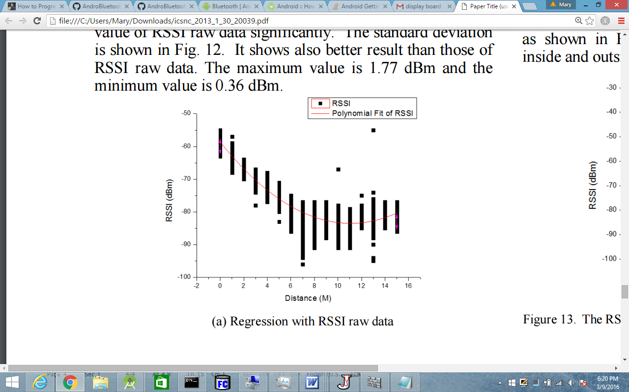
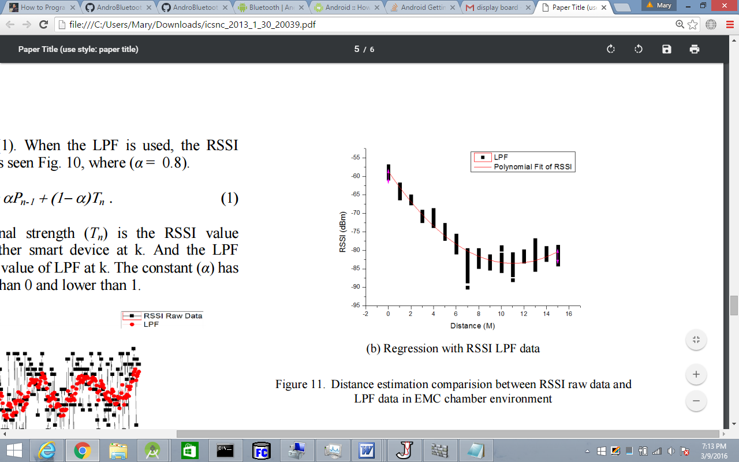
Signal Processing
Magnetometer readings → compass heading → degrees/radians
arccos ( sin (heading) ) = degrees
Bluetooth signal strength (dBm) → physical distance (m)
Taking physical samples to find relationship, not very accurate
Low pass filter (LPF) equation reduce data deviation (Ρ_{n}= αΡ_{n-1} + (1− α)Τ_{n})

Slide 12
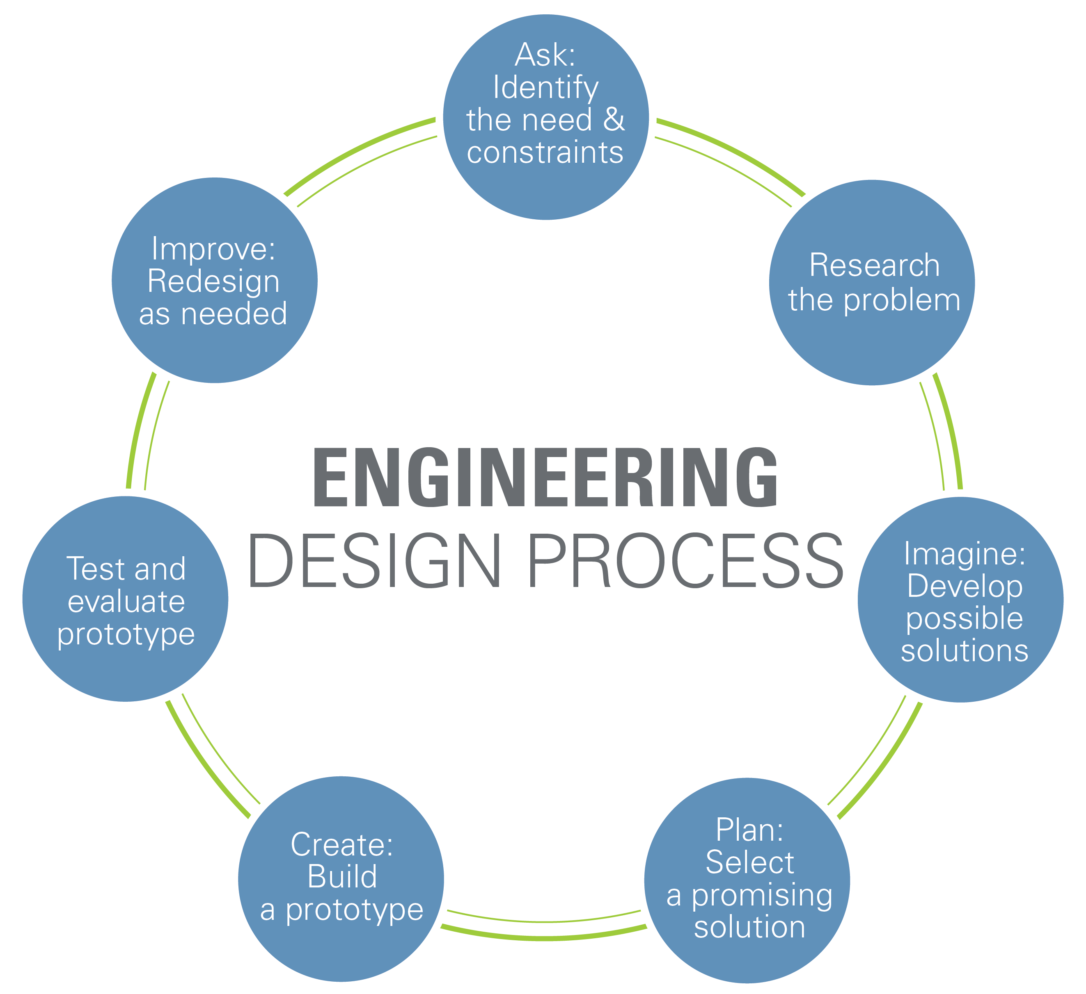
Challenges/Conclusion
Android app programming
Bluetooth class lacks continuous RSSI display functionality
Magnetometer calibration/troubleshooting
Bluetooth to distance inaccuracy
Trial and error
Continuous project
Learning experience

Slide 13
Future Research/Improvements
Adding an accelerometer to improve accuracy when obstructions affect Bluetooth signal
Create a “searching mode”: allows parent to move around in search for child
Also used to search for stationary item (ex. misplaced keys)
Improve range: 2nd device to act as signal bridge, radio signal, cellular network
Reduce size and package of device (custom PCB)
Improve Android application interface & functionality

Slide 14
Works Cited
Bekkelien, Anja. “Positioning Techniques.” Bluetooth Indoor Positioning (2012): 6-8. TaM. University of Geneva, Mar. 2012. Web. 28 Dec. 2015. <http://tam.unige.ch/assets/ documents/masters/bekkelien/Bekkelien_Master_Thesis.pdf>.
“Dead Reckoning.” Encyclopedia Britannica. Encyclopedia Britannica, Inc, 28 Nov. 2014.
Web. 3 Jan. 2016. <http://www.britannica.com/technology/dead-reckoning-navigation>.
Dver, Alyssa. “Preventing Kids From Getting Really Lost.” PARENTGUIDE News. PG Media Network Corporation, n.d. Web. 3 Jan. 2016. <http://www.parentguidenews.com/Articles/ PreventingKidsFromGettingReallyLost>.
Faragher, Ramsey, and Robert Harle. “An Analysis of the Accuracy of Bluetooth Low Energy...” An Analysis of the Accuracy of Bluetooth Low Energy for Indoor Positioning Applications (2014): 201-10. Ramsey M. Faragher. University of Cambridge, Sept. 2014. Web. 6 Jan. 2016. <http://www.cl.cam.ac.uk/~rmf25/papers/BLE.pdf>.
Jung, Kang, and Bae. Distance Estimation of Smart Device Using Bluetooth. ISBN. 978-1-61208-305-6. Deajeon: IARIA, 2013. Print.

Slide 15
Thank you for listening!

